Slide 1
ACM-W SC Learning Bootcamp-2 2021
Online Organic Food Shop (Front end)

Slide 2
Online Organic Food Shop
In this website one can find,
•Desired organic foods
•Health tips
•Food trends
•Contact information
•Social media accounts

Slide 3
Tools Used
•HTML
•CSS
•Bootstrap

Slide 4
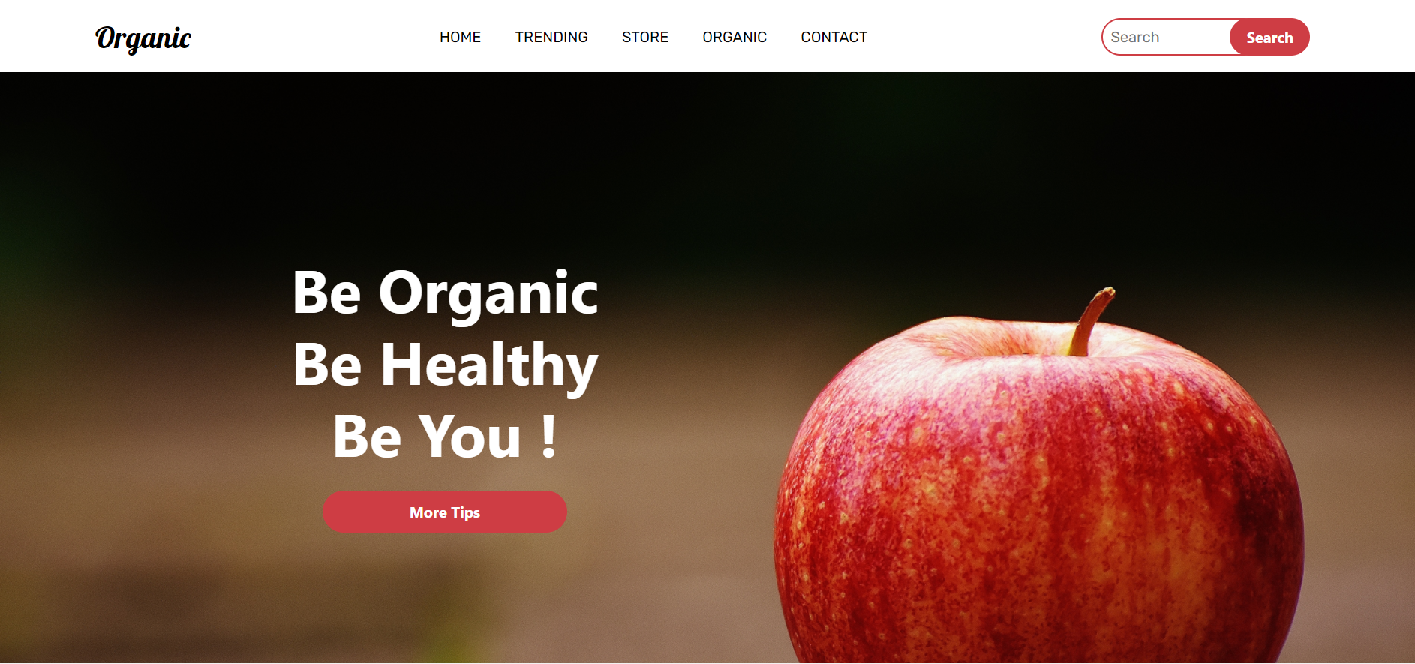
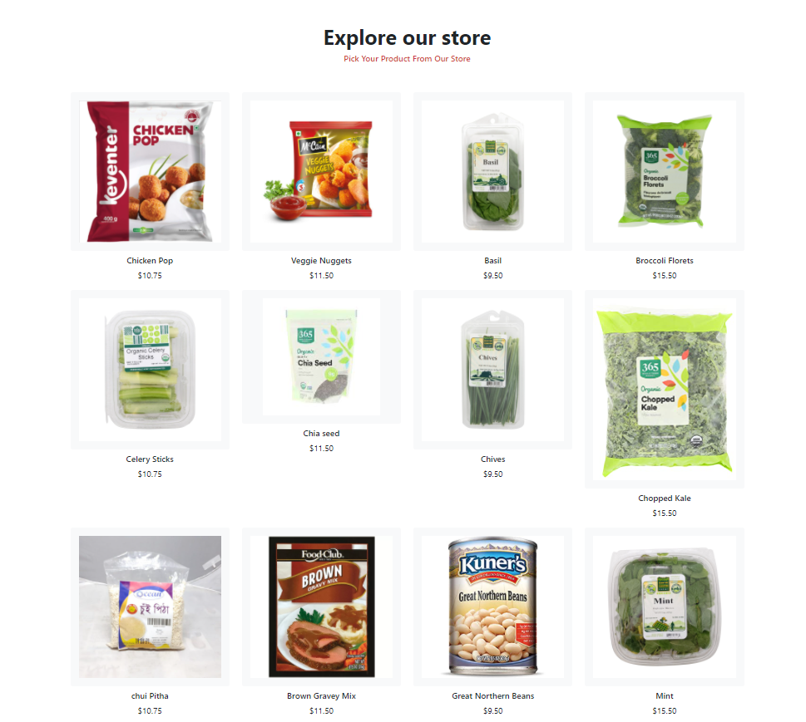

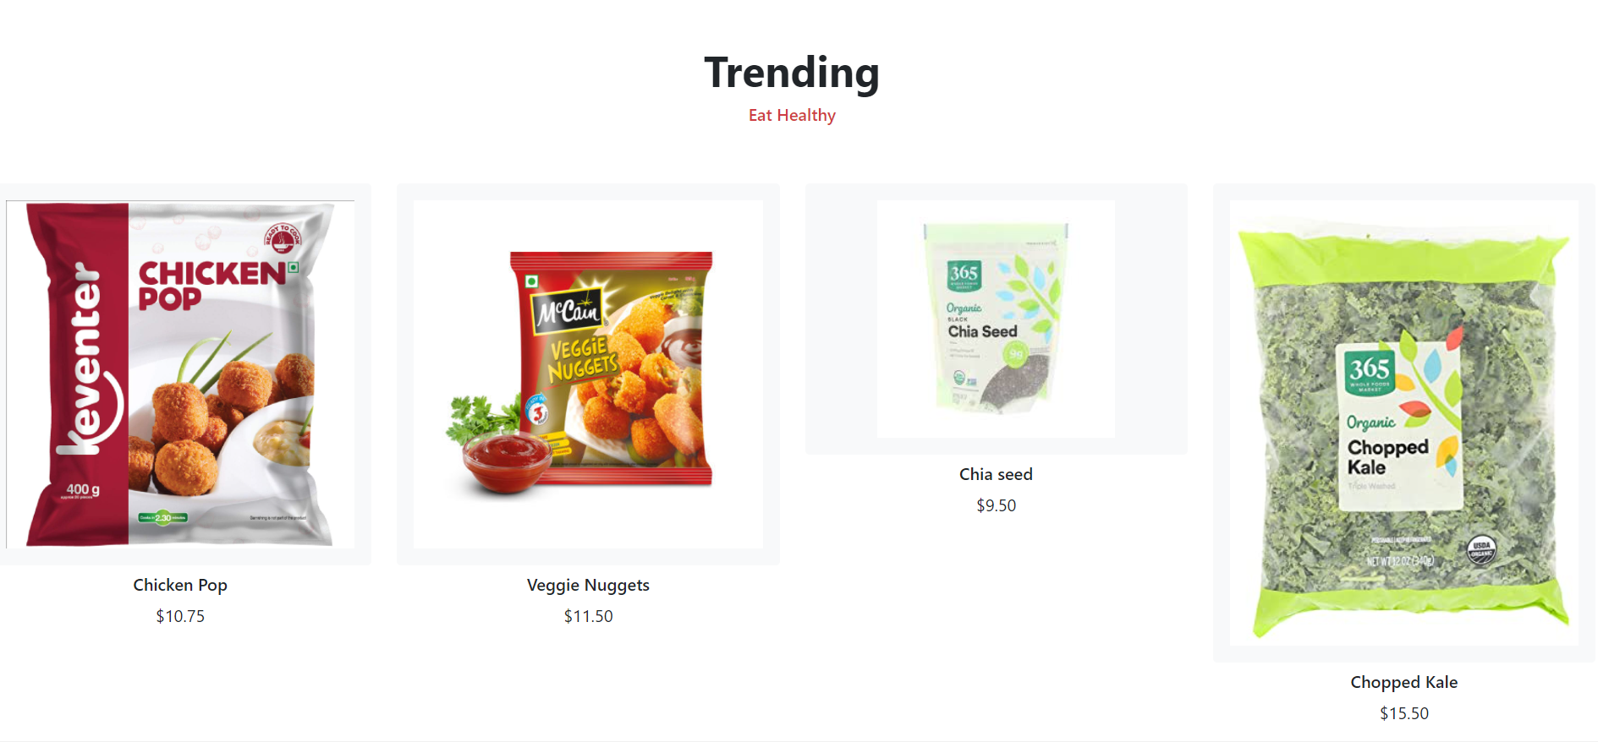

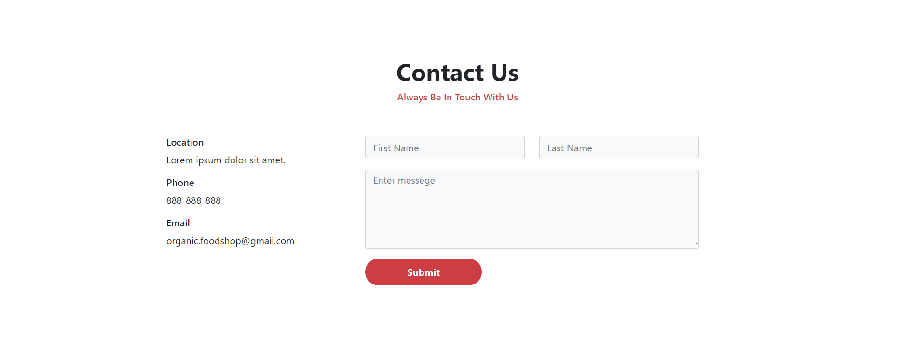
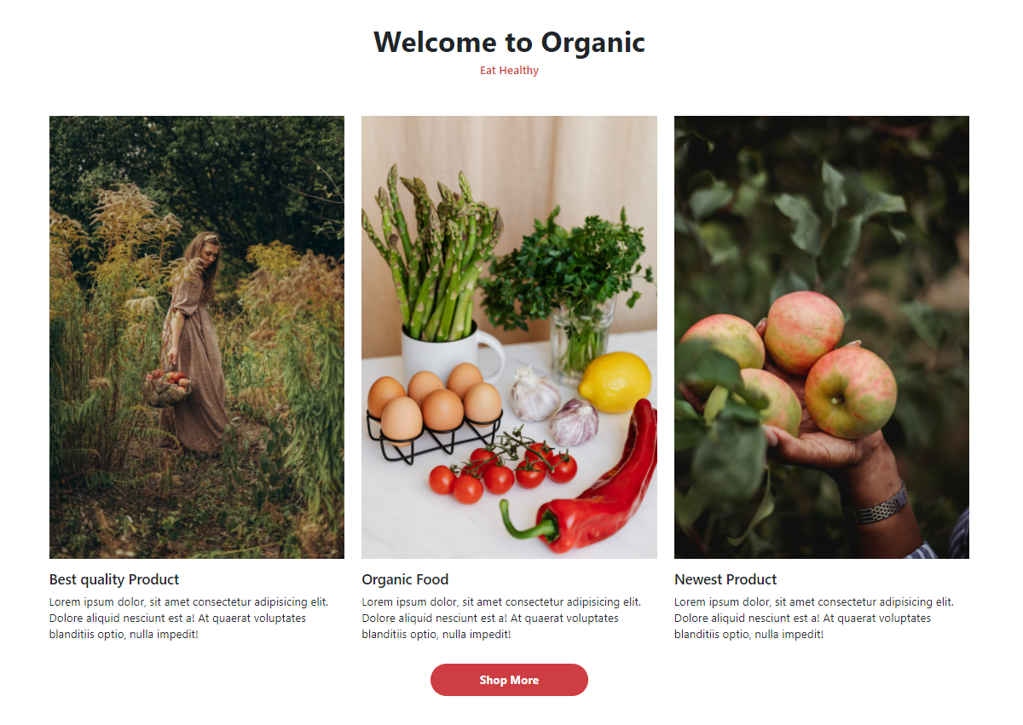
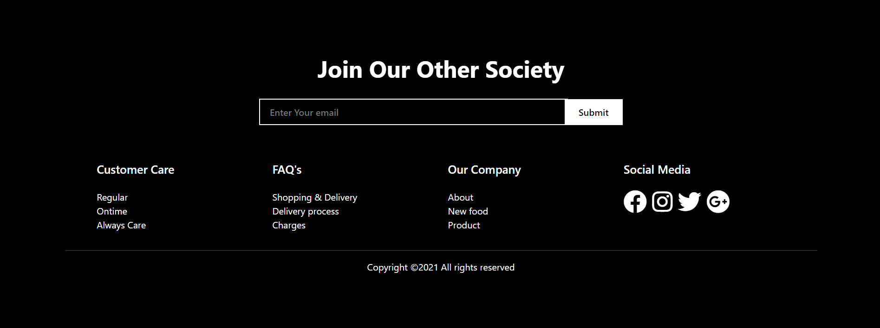
Some Screenshots Of The Website

Slide 5
Thank you

